Slide 1

Python Basics
Dynamic Typing, Core Concepts, Data Types, Strings, List, Tuples, Dictionaries, Functions

Slide 2
Dynamic Typing in Python
Python is a dynamically typed language, meaning that the type of a variable is determined at runtime, not during compilation. You don't need to declare a variable's type explicitly; the interpreter infers it based on the value assigned.
Dynamic Typing
Static Typing
Variable types are checked at runtime. A single variable can hold values of different types throughout its lifecycle.
Variable types are declared and checked at compile time. Once a variable is declared with a specific type, it can only hold values of that type.
Code Example: Runtime Type Change
This example illustrates how a variable x can first hold an integer, then a string, and finally a float, with Python automatically updating its type. The type() function confirms the change at each step, showcasing dynamic typing in action.

Slide 3





Operator Precedence in Python
Operator precedence dictates the order in which operations are performed in an expression.
Understanding this hierarchy is crucial for writing accurate and predictable Python code.
Assignment
Logical
Comparison
Arithmetic
Code Example: Precedence in Action
x = 5
y = 10
# (5 + (10 * 2)) > 20 and (not False)
# (5 + 20) > 20 and True
# 25 > 20 and True
# True and True
result = x + y * 2 > 20 and not False
print(result)
This example shows how multiplication takes precedence over addition, followed by comparison and then logical operations, leading to a True result.

Slide 4
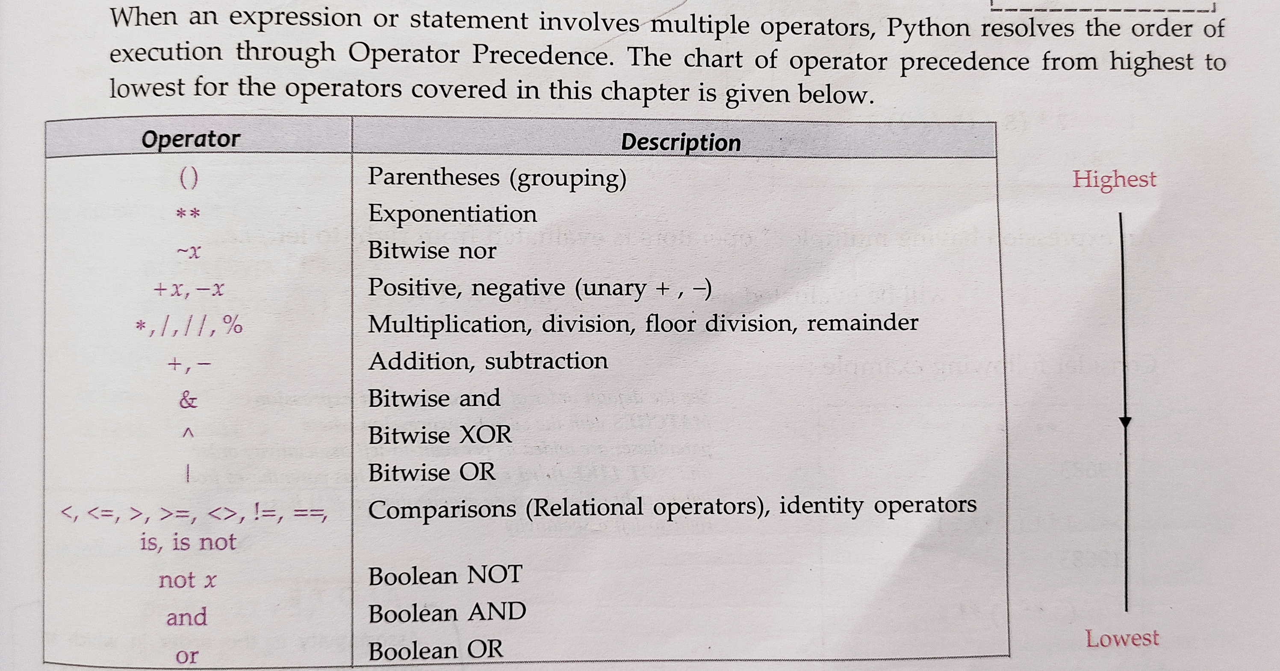

Slide 5
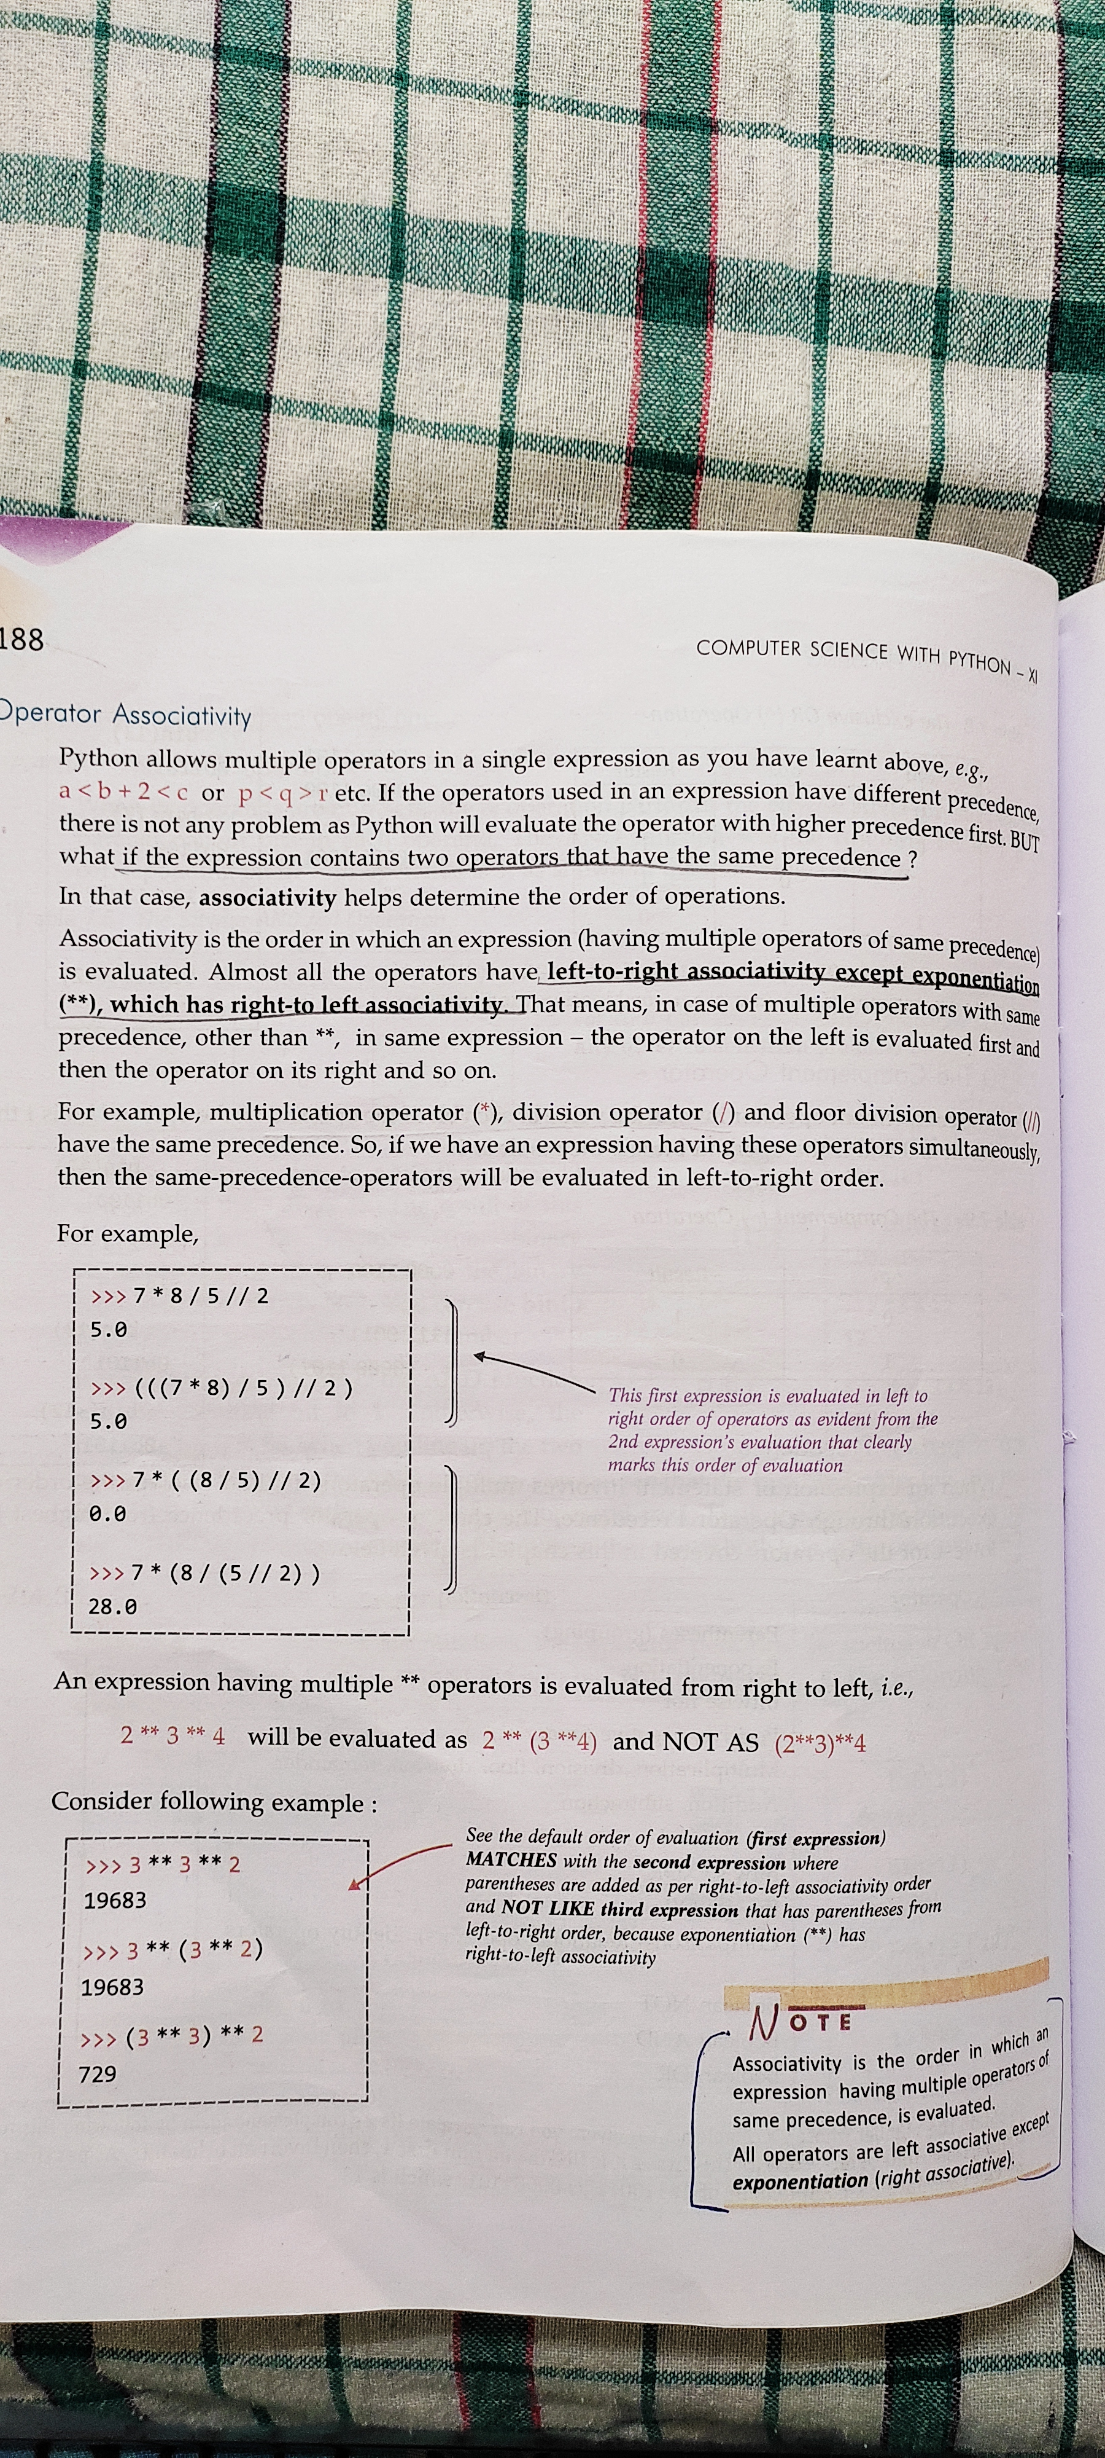

Slide 6








Python's Fundamental Data Types
Python provides several built-in data types to store various kinds of information. Understanding these is key to effective programming.
Integers (`int`)
Floats (`float`)
Whole numbers (positive, negative, or zero) without fractional parts. Ex: 10, -5
Numbers with decimal points or exponents, representing real numbers. Ex: 3.14, 2.0
Strings (`str`)
Booleans (`bool`)
Sequences of characters, enclosed in single or double quotes. Ex: "hello", 'Python'
Represent logical values: True or False. Ex: True
Lists (`list`)
Tuples (`tuple`)
Ordered, mutable collections of items. Enclosed in square brackets []. Ex: [1, "a", 3.0]
Ordered, immutable collections of items. Enclosed in parentheses (). Ex: (1, 2, 3)
Sets (`set`)
Dictionaries (`dict`)
Unordered collections of unique items. Enclosed in curly braces {}. Ex: {1, 2, 3}
Unordered collections of key-value pairs. Enclosed in curly braces {}. Ex: {'a': 1, 'b': 2}

Slide 7
Type Conversion in Python
Python allows explicit type conversion, enabling you to change a variable's data type using built-in functions. This is crucial for operations requiring specific data types.
1
2
3
int(): To Integer
float(): To Float
str(): To String
Converts numeric types or string representations of whole numbers to integers.
Converts integers or string representations of numbers to floating-point numbers.
Converts any data type into its string representation.
print(str(123)) # Output: "123"print(str(True)) # Output: "True"print(str([1, 2])) # Output: "[1, 2]"
print(int(3.14)) # Output: 3print(int("123")) # Output: 123# print(int("3.14")) # Error: ValueError
print(float(5)) # Output: 5.0print(float("2.71")) # Output: 2.71# print(float("abc")) # Error: ValueError
4
5
bool(): To Boolean
list(): To List
Converts values to True or False. Zero, None, and empty sequences/collections are False; others are True.
Converts iterable objects (like strings, tuples, sets) into a list.
print(list("Python")) # Output: ['P', 'y', 't', 'h', 'o', 'n']print(list((1, 2, 3))) # Output: [1, 2, 3]# print(list(123)) # Error: TypeError
print(bool(1)) # Output: Trueprint(bool(0)) # Output: Falseprint(bool("")) # Output: Falseprint(bool("hello")) # Output: True
Understanding these functions is essential for managing data and avoiding type-related errors in your Python programs.

Slide 8
Python Variables and Naming Conventions
Variables are named storage locations that hold data in Python. Choosing clear, descriptive names is crucial for code readability and maintainability. Python follows specific rules and widely-adopted conventions for naming.
1
2
Variable Assignment
Naming Rules
Assign values using the = operator. Type is inferred dynamically.
Must start with a letter or underscore.
Can contain letters, numbers, and underscores.
name = "Alice"age = 30is_active = True
Case-sensitive (age is different from Age).
Cannot be a Python keyword (e.g., if, for, class).
3
4
PEP 8 Guidelines
Common Conventions
Python's style guide emphasizes readability. For variables and functions, use snake_case.
snake_case: Variables, functions.
PascalCase: Class names.
user_data
UPPER_SNAKE_CASE: Constants.
calculate_total
Avoid camelCase for variables/functions (common in other languages).
Adhering to these conventions makes your code more Pythonic and easier for others (and future you) to understand.

Slide 9

Python's Memory Management and Object Identity
Objects and `id()`
Every piece of data in Python is an object, residing at a specific memory location.
The built-in id() function returns the unique identity of an object, which is its address in memory.
a = 10b = "hello"print(id(a))print(id(b))
`is` vs `==` Operators
== checks for value equality (do they contain the same data?), while is checks for object identity
(are they the exact same object in memory?).
list1 = [1, 2]list2 = [1, 2]list3 = list1print(list1 == list2) # True (same value)print(list1 is list2) # False (different objects)print(list1 is list3) # True (same object)
Immutable Objects
Objects like numbers, strings, and tuples are immutable. Once created, their value cannot be changed.
Operations that seem to modify them actually create new objects.
x = 5
print(id(x))x = x + 1 # Creates a new int objectprint(id(x)) # id will be different
Mutable Objects & References
Objects like lists, dictionaries, and sets are mutable. Their content can be changed after creation.
Variables hold references to these objects, meaning multiple variables can point to the same object.
my_list = [1, 2, 3]another_list = my_list # Both reference the same objectmy_list.append(4)print(another_list) # Output: [1, 2, 3, 4]print(id(my_list) == id(another_list)) # True

Slide 10

Python String Functions
Essential Methods for String Manipulation

Slide 11
Python String Functions and Methods
Python provides a rich set of built-in functions and string methods to efficiently manipulate text data. Mastering these is crucial for text processing and data handling.
len(): Get Length
.partition(): Splitting a string
Returns the number of characters in a string.
It splits a sting in a string in the first occurrence of the separator, and returns a tuple of three items with the separator as the middle one.
text = "Python"print(len(text)) # Output: 6
word = "hello World Everyone dEEEvelopers“
print(word.partition(“World”)) # Output: ("HELLO“, “World”, “Everyone dEEEvelopers”)
.lower(): Lowercase , .upper(): Uppercase
Converts all characters in the string to lowercase, or uppercase
.strip(): Remove Whitespace
word = "WORLD“
print(word.lower()) # Output: "world“
word = "hello“
print(word.upper()) # Output: "HELLO"
Returns a copy of the string with leading and trailing whitespace removed.
data = " Python is fun "print(data.strip()) # Output: "Python is fun"
.replace(): Substitute Text
.split(): Break Apart
Replaces all occurrences of a specified substring with another substring.
Splits the string into a list of substrings using a specified delimiter.
sentence = "Hello world“
print(sentence.replace("world", "Python")) # Output: "Hello Python"
items = "apple,banana,cherry“
print(items.split(",")) # Output: ['apple', 'banana', 'cherry']
.join(): Combine Elements
.find(): Locate Substring
Concatenates elements of an iterable (e.g., list of strings) using the string as a separator.
Returns the lowest index of the substring if found, otherwise returns -1.
words = ["Python", "is", "awesome"]
print(" ".join(words)) # Output: "Python is awesome"
text = "programming“
print(text.find("gram")) # Output: 3
.startswith(): Check Prefix
.endswith(): Check Suffix
Returns True if the string starts with the specified prefix, otherwise False.
Returns True if the string ends with the specified suffix, otherwise False.
email = user@example.com
print(email.startswith("user")) # Output: True
filename = "report.pdf“
print(filename.endswith(".pdf")) # Output: True
These methods allow for powerful and flexible manipulation of text, an essential skill in any Python project.

Slide 12
Python String Indexing and Slicing
String indexing and slicing are powerful mechanisms to access and manipulate portions of text data. They allow precise control over individual characters and substrings.
1
2
3
Individual Character Access
Basic Slicing [start:end]
Advanced Slicing [start:end:step]
Strings are ordered sequences. You can access individual characters using their index. Positive indices start from 0 for the first character, while negative indices start from -1 for the last character.
Slicing extracts a substring from a given range. The start index is inclusive, and the end index is exclusive. If start or end are omitted, they default to the beginning or end of the string, respectively.
The optional step argument specifies how many characters to skip. A negative step reverses the string. Omitting start and end with a negative step is a common way to reverse a string entirely.
my_string = "Python"print(my_string[0])
# Output: P (first character)
print(my_string[5])
# Output: n (last character)
print(my_string[-1]) # Output: n
(last character using negative index)
print(my_string[-6]) # Output: P
(first character using negative index)
greeting = "Hello, World!“
print(greeting[0:5])
# Output: Hello
print(greeting[7:12])
# Output: World
print(greeting[:5])
# Output: Hello (from beginning to index 5)
print(greeting[7:])
# Output: World! (from index 7 to end)
sentence = "Programming“
print(sentence[0:11:2])
# Output: Prgamn (every second character)
print(sentence[::3])
# Output: Pmng (every third character)
print(sentence[::-1])
# Output: gnimmargorP (reversed string)
print(sentence[5:0:-1])
# Output: marg (from index 5 down to 1)
Mastering these techniques provides incredible flexibility for manipulating and processing text data in Python programs.

Slide 13
Python String Formatting
Python offers several powerful ways to format strings, allowing for dynamic content generation and precise control over presentation. Understanding these methods is key for clean and readable output.
`%` Formatting (Legacy)
The oldest method, similar to C's `printf`, using `%` operators as placeholders. While functional, it's less readable and can be error-prone with complex structures.
name = "Alice"age = 30pi = 3.14159print("Name: %s, Age: %d, Pi: %.2f" % (name, age, pi))
`.format()` Method
Introduced in Python 2.6, this method uses `{}` placeholders and provides more control through positional and keyword arguments, enhancing readability and flexibility.
name = "Bob"score = 95.876print("Hello, {0}! Score: {1:.1f}.".format(name, score))print("{:<10} {:>10}".format("Left", "Right"))
f-strings (Python 3.6+)
Formatted String Literals, prefixed with `f` or `F`, are the most modern and recommended approach. They allow embedding expressions directly within string literals, making them concise and highly readable.
item = "Laptop"price = 1200quantity = 2print(f"Item: {item}, Total: ${price * quantity:.2f}")aligned_text = f"{'Centered':^20}"print(aligned_text)
Choosing the right formatting method can significantly improve code clarity and maintainability, with f-strings generally being the preferred choice in modern Python.

Slide 14
Python List Functions
Essential Methods for List Manipulation

Slide 15




Adding Elements to Lists
Python provides several versatile methods to add elements to lists, each suited for different scenarios. Understanding their behavior is key to efficient list manipulation.
append()
insert()
Adds a single element to the end of the list. It modifies the original list in-place.
Adds a single element at a specified index, shifting existing elements to the right.
my_list = [1, 2]
my_list.append(3)
# [1, 2, 3]
my_list = [1, 2, 4]
my_list.insert(2, 3)
# [1, 2, 3, 4]
extend()
+ Operator
Appends all elements from an iterable (like another list) to the end of the current list, in-place.
Creates a new list by concatenating two or more lists. It does not modify the original lists.
list_a = [1, 2]
list_b = [3, 4]
list_a.extend(list_b)
# [1, 2, 3, 4]
list_a = [1, 2]
list_b = [3, 4]
new_list = list_a + list_b
# new_list is [1, 2, 3, 4]

Slide 16




Removing Elements from Lists
Mastering element removal is crucial for dynamic list management. Each method serves a specific purpose, offering control over how and what is removed from your Python lists.
remove()
pop()
Removes the first occurrence of a specified value. It modifies the list in-place and returns None. Use when you know the value to delete.
Removes and returns the element at a given index. If no index, it removes and returns the last item. Use when you need the removed element or to remove by index.
my_list = [1, 2, 3, 2]
my_list.remove(2)
# [1, 3, 2]
my_list = [1, 2, 3]
popped_item = my_list.pop(1)
# my_list is [1, 3], popped_item is 2
del Statement
clear()
Deletes an item or a slice of items by index. It's a statement, not a method, and doesn't return any value. Can also delete the entire list object. Use for precise index-based deletion.
Removes all elements from the list, making it empty. It modifies the original list in-place and returns None. Use when you want to empty the list completely.
my_list = [1, 2, 3]
my_list.clear()
# []
my_list = [1, 2, 3, 4]
del my_list[1:3]
# [1, 4]

Slide 17
Finding and Searching in Lists
Python provides several intuitive methods and operators for efficiently finding and searching within lists. These tools are fundamental for data analysis and conditional logic in your programs.
index()
count()
Returns the zero-based index of the first occurrence of a specified value. Raises a ValueError if the item is not found.
Counts and returns the number of times a specified value appears in the list. Useful for frequency analysis.
fruits = ['apple', 'banana', 'cherry', 'apple’]
index_val = fruits.index('banana’)
# index_val is 1
numbers = [1, 2, 2, 3, 2, 4]
count_val = numbers.count(2)
# count_val is 3
in operator
max()/min()
Checks for membership. It returns True if an item exists in the list, and False otherwise. It's concise and readable.
Built-in functions to find the largest (max()) and smallest (min()) elements in a list. Works with any comparable data types.
colors = ['red', 'green', 'blue’]
is_present = 'green' in colors
# is_present is True
scores = [85, 92, 78, 95]
highest = max(scores) # highest is 95
lowest = min(scores) # lowest is 78

Slide 18
Sorting and Reversing Lists
Python offers powerful ways to reorder lists, whether you need to sort elements, reverse their order, or apply custom logic for arrangement.
sort()
Sorts the list *in-place*, modifying the original list and returning None. Use `reverse=True` for descending order.
1
my_list = [3, 1, 2]
my_list.sort() # [1, 2, 3]
sorted()
Returns a *new sorted list*, leaving the original list unchanged. It can sort any iterable, not just lists.
2
original = [3, 1, 2]
new_list = sorted(original) # [1, 2, 3]
reverse()
Reverses the elements of the list *in-place*, modifying the original list and returning None.
3
my_list = [1, 2, 3]
my_list.reverse() # [3, 2, 1]
reversed()
Returns a *reverse iterator* over the list, not a new list. The original list remains unchanged. Convert to list if needed.
4
original = [1, 2, 3]
reversed_iter = reversed(original) # iteratornew_list = list(reversed_iter) # [3, 2, 1]
key Parameter
Used with `sort()` or `sorted()` to provide a function that extracts a comparison key from each element for custom sorting.
5
words = ["apple", "cat", "banana"]
sorted_by_len = sorted(words, key=len) # ["cat", "apple", "banana"]

Slide 19




List Copying and Slicing
Understanding how to copy and slice lists is crucial for preventing unintended side effects when modifying data. Python offers methods for both shallow and deep copying, each with distinct behaviors.
Shallow Copy: [:] or .copy()
Deep Copy: copy.deepcopy()
Creates a new list, but references the same objects as the original for its elements. Changes to mutable elements (like nested lists) in the copy will affect the original.
Creates a completely independent new list and recursively copies all objects found within the original. Modifications to the deep copy will not affect the original list or its nested elements.
original = [1, [2, 3], 4]
shallow_copy = original[:] or original.copy()
shallow_copy[1][0] = 99
\# original becomes [1, [99, 3], 4]
import copy
original = [1, [2, 3], 4]
deep_copy = copy.deepcopy(original)
deep_copy[1][0] = 999
# original remains [1, [2, 3], 4]
List Slicing
When to Use
Extracts a portion of a list to create a new list. It supports start, stop, and step arguments. If no step is provided, it creates a shallow copy of the sliced portion.
Shallow Copy: For lists with only immutable elements (numbers, strings, tuples) or when you want shared references for mutable nested objects.
Deep Copy: For lists containing mutable objects (like nested lists or dictionaries) that you need to modify independently of the original.
my_list = ['a', 'b', 'c', 'd', 'e’]
slice1 = my_list[1:4] # ['b', 'c', 'd’]
slice2 = my_list[::2] # ['a', 'c', 'e']
Slicing: To extract subsets of a list without altering the original, or to create a shallow copy of the entire list (my_list[:]).

Slide 20

List Comprehensions & Advanced Operations
Python's list comprehensions offer a concise way to create lists, while powerful built-in functions extend iterable manipulation.
Mastering these techniques leads to more readable and efficient code.
Nested & Conditional Comprehensions
List Comprehensions
Embed multiple for loops for complex structures, and use if clauses to filter elements or apply conditional expressions.
A compact way to create lists. They consist of brackets containing an expression followed by a for clause, then zero or more for or if clauses.
pairs = [(x, y) for x in 'AB' for y in '12’]
# [('A', '1'), ('A', '2'), ('B', '1'), ('B', '2’)]
evens = [x for x in range(10) if x % 2 == 0]
# [0, 2, 4, 6, 8]
squares = [x**2 for x in range(5)]
# [0, 1, 4, 9, 16]
map() & filter()
zip() & enumerate()
map() applies a function to all items in an input list. filter() constructs a new list from elements for which a function returns True.
zip() aggregates elements from multiple iterables. enumerate() adds a counter to an iterable and returns it as an enumerate object.
numbers = [1, 2, 3, 4]
squared = list(map(lambda x: x**2, numbers))
# [1, 4, 9, 16]
greater_than_2 = list(filter(lambda x: x > 2, numbers))
# [3, 4]
names = ['Alice', 'Bob’]
ages = [30, 24]
combined = list(zip(names, ages))
# [('Alice', 30), ('Bob', 24)]
for i, name in enumerate(names):
# 0 Alice, 1 Bob

Slide 21
Python Tuple Functions
Essential Methods for Tuple Manipulation

Slide 22
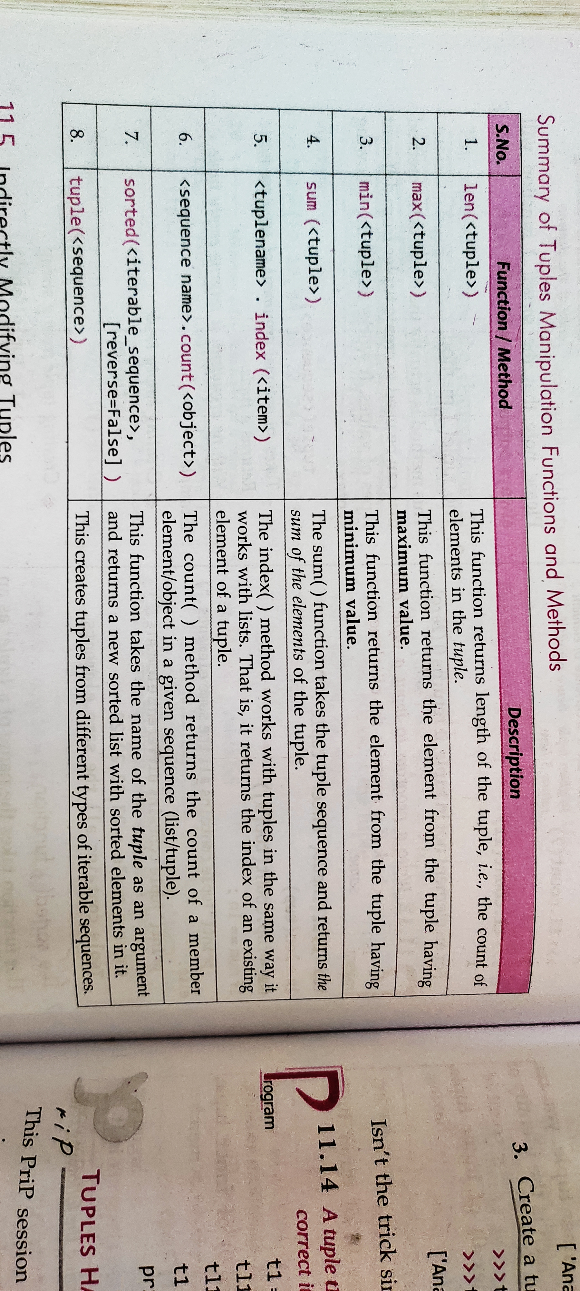

Slide 23
Python Dictionary Functions
Essential Methods for Dictionary Manipulation

Slide 24
